Slide 1
MTA in the Age of Big Data: Transforming the Wealth of MTA Data into Accessible, Meaningful, Visual, Interactive Information
A Presentation to
The New York Metropolitan Transportation Council
April 24, 2013
by
Ellyn Shannon, Senior Transportation Planner, PCAC
Angela Bellisio, Research Assistant, PCAC

Slide 2
Issue:
How to help Riders, Decision Makers, MTA Staff Understand:
Where the MTA is doing well?
Where it needs to improve?
Where it needs to invest?
Where is it efficient?
Where is it inefficient?

Slide 3
1,000 Pages every month

Slide 4
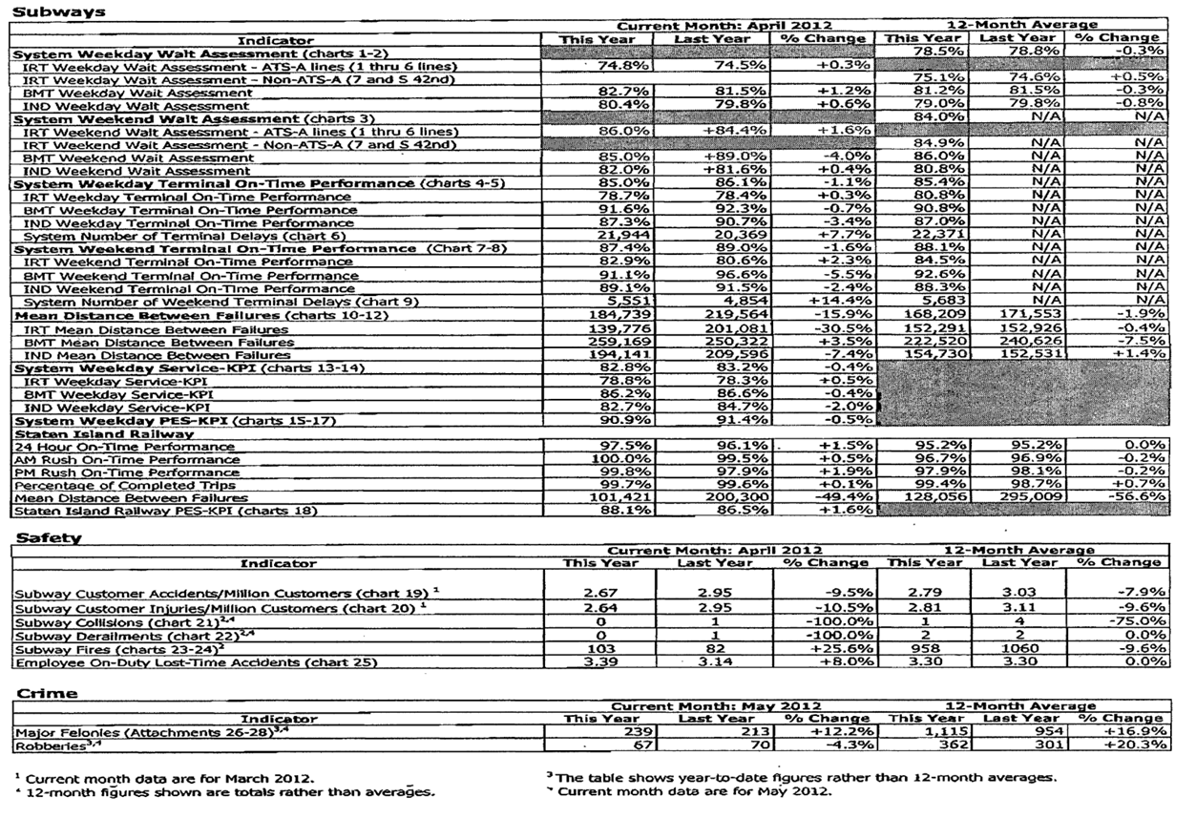
Remarkable information trapped in static black and white charts

Slide 5
Problem:
Monthly and year-to-date performance data released each month.
No performance in the perspective of time:
3 years, 5 years, 10 years…
No ability to see long term trend lines.

Slide 6
Solution: Data Visualization!
A Means to explain and interact with data in a more intuitive way.

Slide 7
Interviews and Meetings Begin
Two terms that paralyzed discussions early on:
“Data Requests”
“Data Visualization”

Slide 8
MTA Data Request Challenges
Hundreds of Data Bases
Legacy systems
Lack of systems integration and data standardization across agencies.
Unstructured data is difficult to manage and present in a format that can be easily accessed and visualized.
Cultural practices are deeply embedded at the MTA and may take time to change.

Slide 9
Data Visualization Challenges
Understanding what the term
“Data Visualization”
means.

Slide 10
Create a Data Visualization Demonstration Project
Questions for the Demonstration Project:
Can 1,000 pages monthly be more efficient and effective?
What would it look like to show MTA trend lines over time?

Slide 11
5 Years of Transit Performance Data January 2008 – February 2013

Slide 12
Transform the Numbers on the Page into Accessible Information

Slide 13
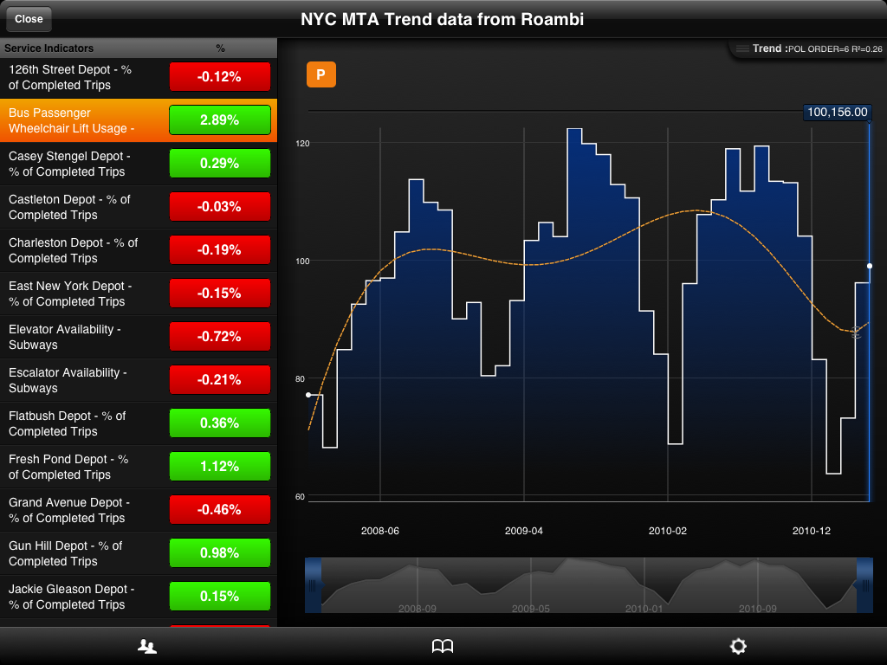
Intuitive Information

Slide 14
Helping Stakeholders to Understand Trends More Efficiently
Internal Stakeholders:
Management
Staff
Contractors
Vendors
MTA Board
External Stakeholders:
Elected Officials
Transit Advocates
Riders
The Press

Slide 15
Recommendations
Develop a strategic vision for data analytics and visualization.
Invest in new technologies.
Invest in staff training and conference attendance to ensure appropriate competencies, capacity, and culture change.
Create three data visualization pilot projects to move data visualization forward at the MTA.

